Slide 1


Blockchain & Logistics
Fintech Project
iTrack
Tony Huang
Satoru Yamada
Jay Cao
Anh Thi Dang
GROUP B

Slide 2
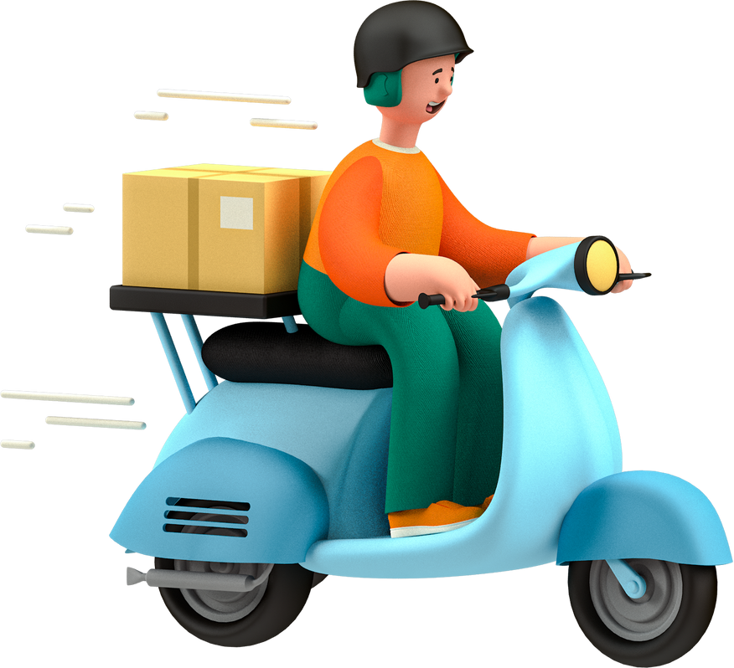

ABOUT US
We're a shipping company, providing global tracking services to our customers.
iTrack app is a tracking service that utilizes blockchain to help courier and customers to track shipping items.

Slide 3
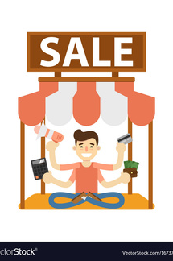


How iTrack works
Sellers, Couriers and Customers will be iTrack users
SELLERS/ADMIN
COURIERS
CUSTOMERS
Admin controls the contract, and will be able to whitelist courier and user address, while also being able to log and track shipping information
The courier has ability to log shipping information using IPFS onto the blockchain.
The user will be able track the item only.

Slide 4






Technologies Employed
Ethereum - the most popular decentralised flatform for smart contract
IPFS - a peer-to-peer hypermedia protocol designed to preserve and grow humanity's knowledge by making the web upgradeable, resilient, and more open
Web3js – is a collection of libraries that allow us to interact with a local or remote ethereum node using HTTP, IPC or WebSocket.
HTML - standard markup language for documents designed to be displayed in a web browser
Java Script - one of the core technologies of the World Wide Web, alongside HTML and CSS
CSS - is used for defining the styles for web pages.

Slide 5
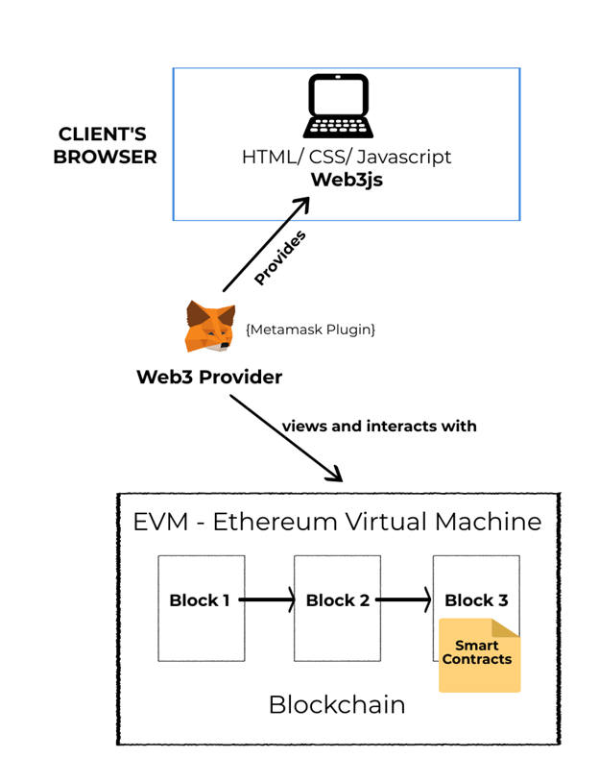


Slide 6
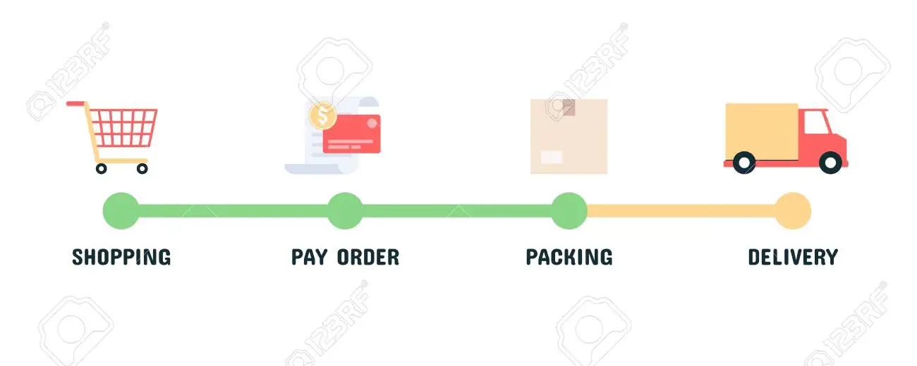
How we build iTrack
STEP 1
STEP 2
STEP 5
Add Courier
We can add courier (hash accounts) so that only Couriers can update the status of the parcel.
Add Customer
Add customer (hash accounts) so that customers can view the statuses of their parcel(s).
Track Status
Customers can view but not update the full history of the parcel's life cycle.
STEP 3
STEP 4
Add Parcel
Only couriers can add a new parcel for tracking
Update Status
Couriers can update the status of the parcel many times during the life cycle of the logistics.

Slide 7
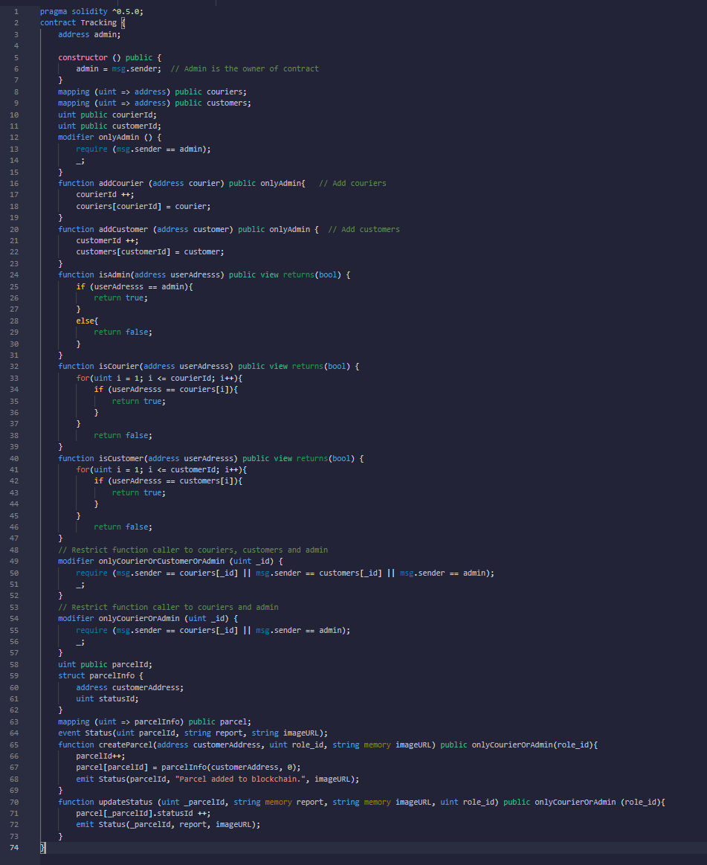
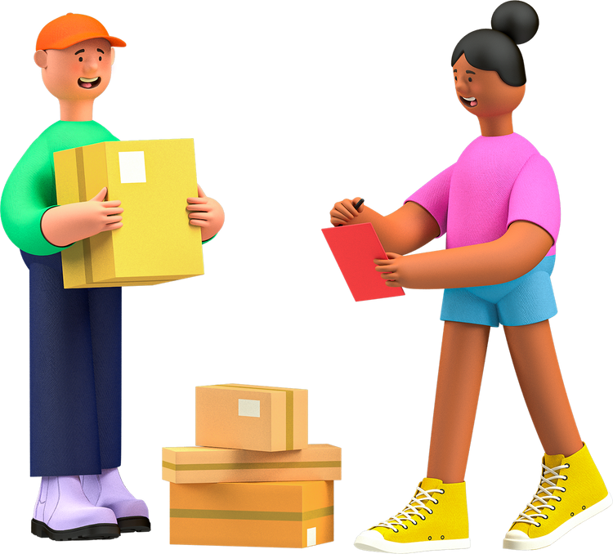
Smart Contracts

Slide 8

DEMO

Slide 9

Improvements
Adding marketplace - users can exchange products and logistics becomes a feature of the marketplace, i.e ebay, shopify.
Handling of payments - using blockchain technology to handle payments between the sellers and buyers.
Creating self contained blockchain - minimising gas fees when compared to Ethereum flatform.
Acquiring barcode function - couriers and customers can scan to tracking shipping items.
Creating address (mneumonics) for each parcel as the tracking number.

Slide 10



Thank you!

Slide 11


Do you have any questions?

